Slide 1
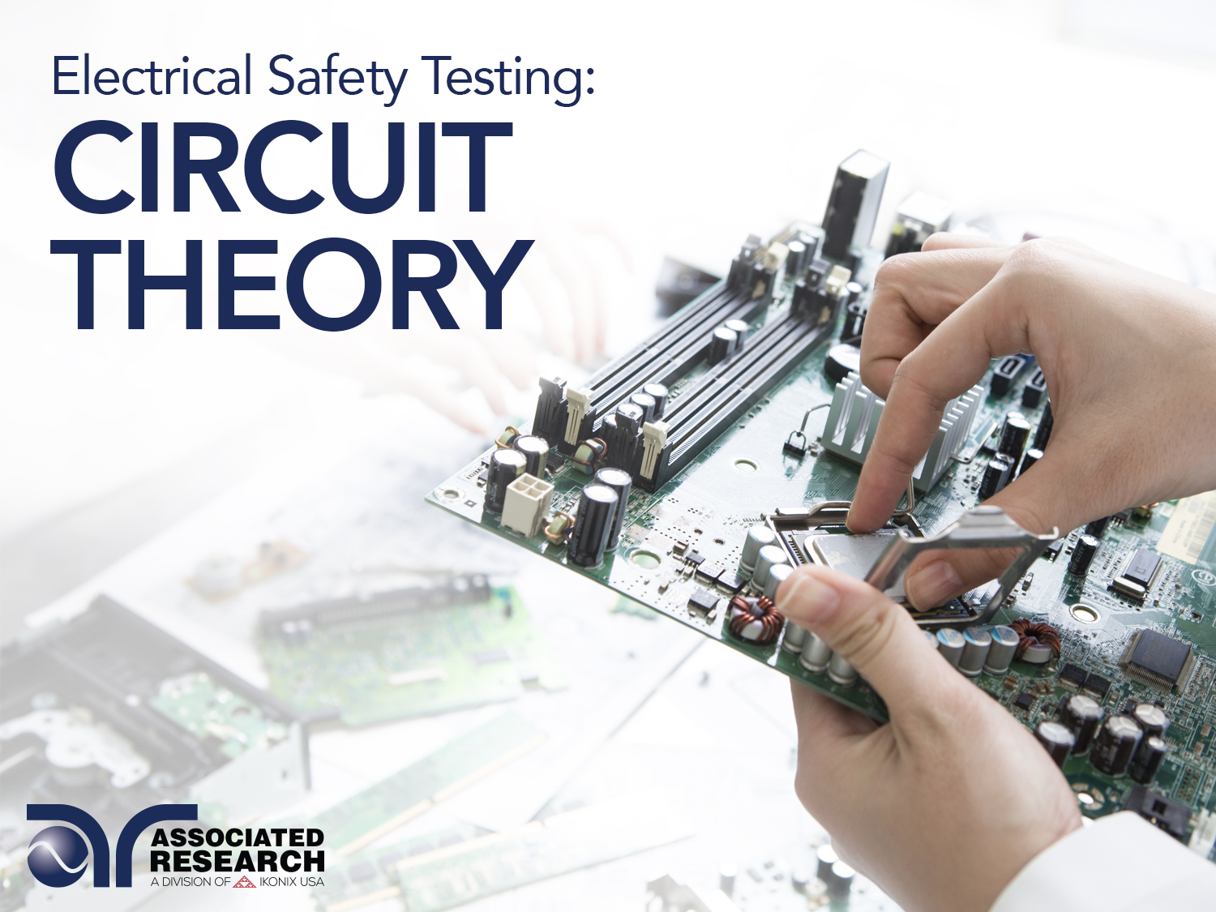

Slide 2


Slide 3
Webinar Notes
Please use the Q & A utility to ask us any questions concerning the material being presented.
Any questions related to running of the meeting (audio and visual, etc.) can be addressed to the host, Brittany Socha, through the chat line.
The webinar is being recorded and will be available to view usually within a day on our website arisafety.com/webinars
Please contact Brittany Socha – on the chat line or email brittany.socha@arisafety.com if you would like a copy of this presentation.

Slide 4
Learning Objectives
Review of electrical safety tests
What part of the product is tested during each test?
Electrical circuits for safety tests
Arc detection and SmartGFI circuits

Slide 5
Common Electrical Safety Tests
Ground Continuity Test
Ground Bond Test
Dielectric Withstand Test (Hipot)
Insulation Resistance Test
Touch Current Test (Leakage Current Test)

Slide 6
Poll Question
What department in your company is responsible for ensuring that your Electrical Safety Testing is being performed properly?

Slide 7
Ground Continuity Test
This test verifies a connection between exposed conductive parts and the ground of the power cord on the product under test.
Routine production line test conducted on Class I products.
A low voltage AC or DC signal is applied from the chassis of the product to the ground pin.
Typically performed at a current under 1A to check that the ground connection is continuous.

Slide 8
Ground Bond Test
This test verifies the integrity of the ground connection between exposed metal and ground wire of the power cord.
High current is injected into the ground pin of the product’s power cord which flows through the chassis.
Determines if the safety ground wire is capable of handling excessive current flow in case a fault occurs and the product’s insulation fails.
Notes:
If a Ground Bond test is performed, Ground Continuity test is not necessary.

Slide 9
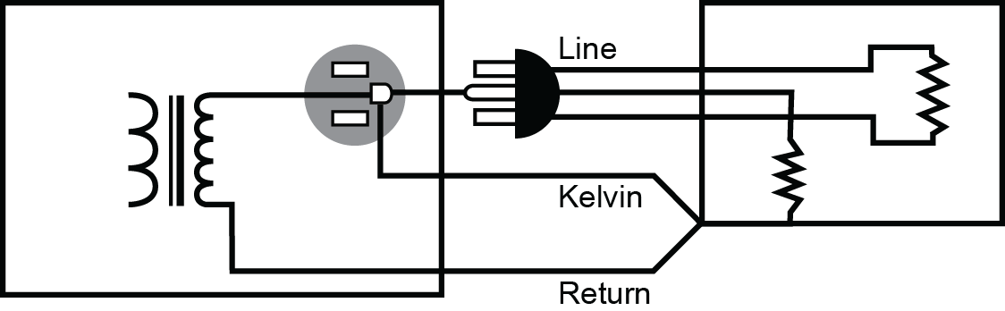
Ground Bond Test
Circuit for Ground Bond Test
The kelvin method is a standard four wire measurement method used during a Ground Bond test to eliminate the inherent test lead resistance from the test results. The Kelvin Method provides more accurate resistance measurements which are crucial when dealing with the miniscule resistance values measured during a Ground Bond test.

Slide 10
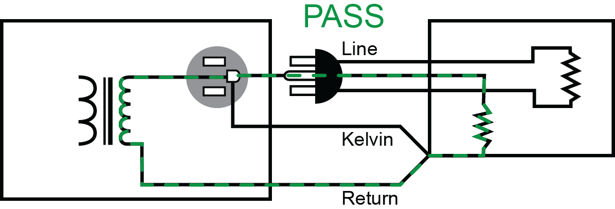
Ground Bond Test

Slide 11
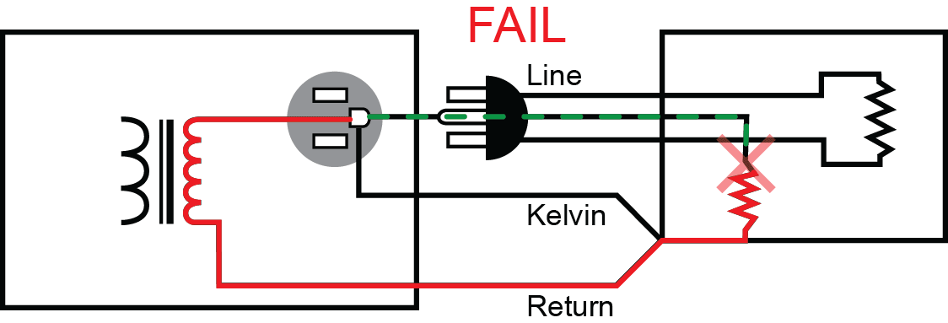
Ground Bond Test

Slide 12
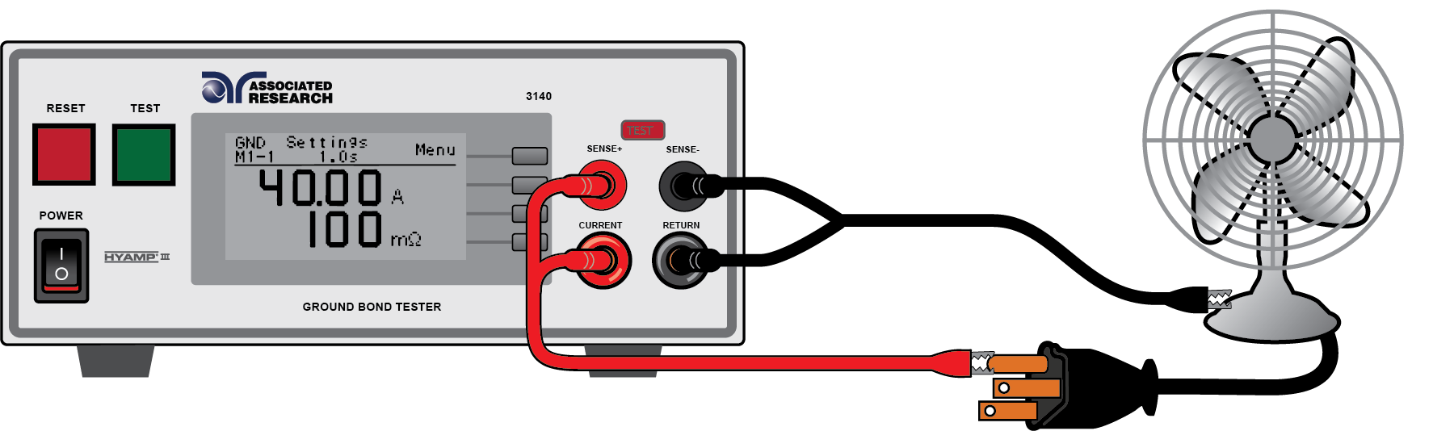
Ground Bond Test
The Ground Bond test is commonly considered a Type test
The results of this test are displayed in Ohms (Ω)
The ground conductor of a product must have a low enough impedance to handle any fault current

Slide 13
Ground Bond Test
Test parameters for Ground Bond test vary from standard to standard.
Manufacturers must consult the safety standard which they are trying to comply with before setting test parameters.
For example, UL 60950 IT Equipment (Type Test) calls out for the test current to be twice the fuse rating of the product or twice the current rating of the circuit under test.
Test voltage is not to exceed 12V and the duration of the test to be 120 seconds.
Test current could be AC or DC based on the product and the safety standard.

Slide 14
Dielectric Withstand Test
Also referred to as Hipot test, it is used to determine whether the insulation of a product is able to withstand an over-voltage condition for a period of time without breaking down.
It is a deliberate application of high voltage potential between the mains input and any exposed dead-metal.
The resulting leakage current (due to the application of high voltage) is measured to determine whether a product’s insulation is able to withstand the high voltage without breaking down.
This test verifies that the insulation of a product is capable of protecting the user from any leakage currents as a result of an electrical fault within the product.

Slide 15
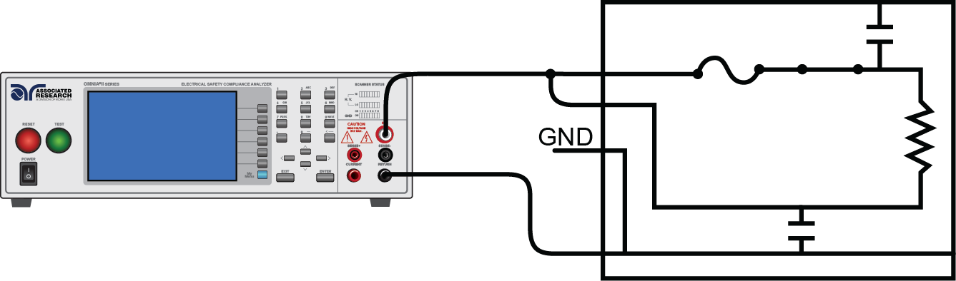
Dielectric Withstand Test
Can be a Type test or a Routine test.
Used to detect possible defects in the design of a product and workmanship defects such as inadequate creepage and clearance distances.

Slide 16
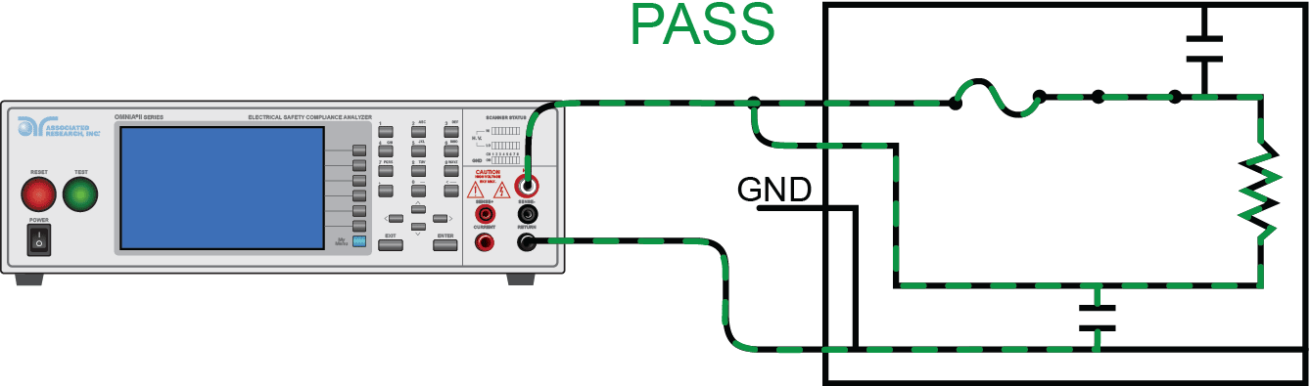
Dielectric Withstand Test

Slide 17
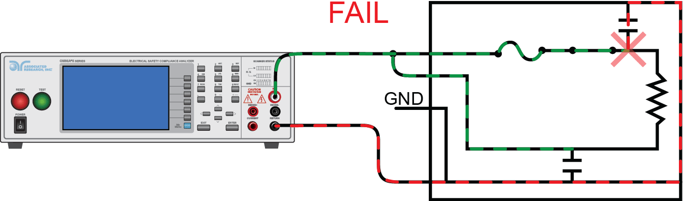
Dielectric Withstand Test

Slide 18
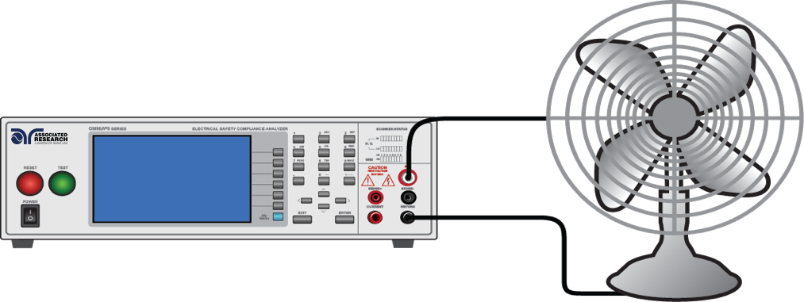
Dielectric Withstand Test
Leakage current is present in every product to some degree.
Leakage current becomes a problem when it reaches excessive levels due to dielectric breakdown.
Result is displayed in mA or µA depending on test type.

Slide 19
Dielectric Withstand Test
Test is performed on both Class I and Class II products.
Test can be performed in both AC and DC mode based on the safety standard.
Test voltage and trip settings must be specified by the manufacturer in accordance with the safety standard.
Most standards specify the test voltage to be calculated using the following formula:
2 x Products Rated Voltage plus 1000 Volts

Slide 20
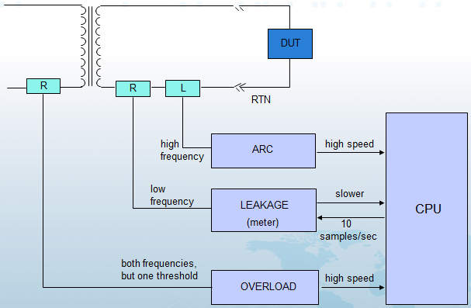
Failure Detection

Slide 21
Insulation Resistance Test
Similar to a DC Dielectric Withstand Test and stresses the same insulation on a product as the DCW test and provides a quantifiable value of the product’s insulation.
Hence, the least commonly specified electrical safety test.v
Commonly performed on serviced and repaired units to verify product integrity.
Results in a resistance measurement .
Most standards specify test voltage at 500 or 1000 Volts.
High insulation resistance value indicates good insulation.

Slide 22
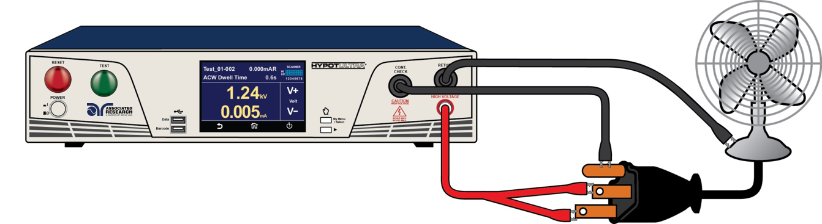
Insulation Resistance Test
Like other electrical safety tests, test parameters vary upon the standard.
EN 60204-1 Safety Of Machinery, specifies a 500 Volts DC test between the power circuit conductors and protective bonding circuit, the resistance shall not be less than 1 MΩ.

Slide 23
Leakage Current Test
Line Leakage test is performed on electrical products to measure the leakage current which could flow through a person while the product is operating.
A measuring device (MD) is used to simulate the impedance of the human body under different conditions depending upon the application of the product.
Test is run under both normal and single fault conditions and reversed polarity on the input line power at 110% of rated input.
Most commonly performed on medical equipment.

Slide 24
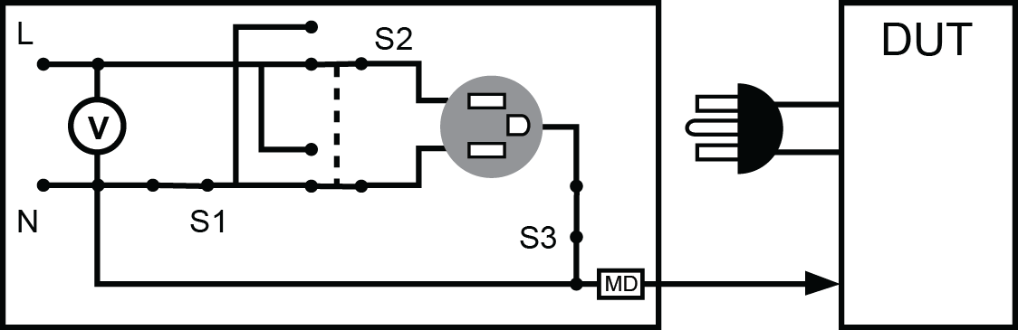
Leakage Current Test
Typical Circuit for Leakage Current Test

Slide 25
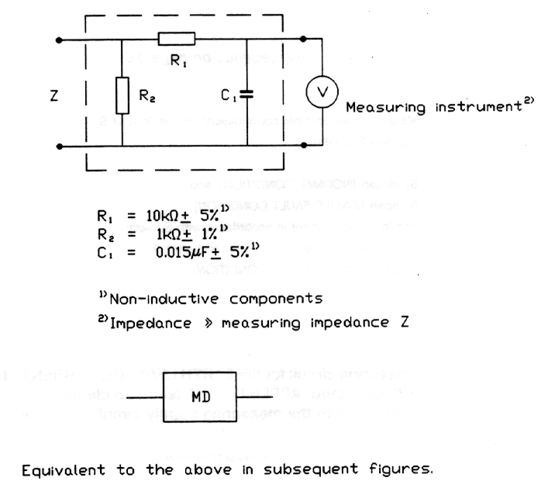
Leakage Current Test
The MD can vary from standard to standard.
Measuring device for EN 60601-1 Medical Electrical Equipment.

Slide 26
Quiz Question
In order to help ensure operator safety which of the following features would you utilize?

Slide 27
SmartGFI®
The SmartGFI® is a patented safety feature in all Associated Research high voltage safety testers
The Associated Research’s SmartGFI® circuit will shut down high voltage if excess leakage is detected through the ground circuit
This is a high-speed shutdown circuit that disables the high voltage in less than 1 millisecond
It is an active circuit which monitors the configuration of the return connection and automatically sets itself accordingly

Slide 28
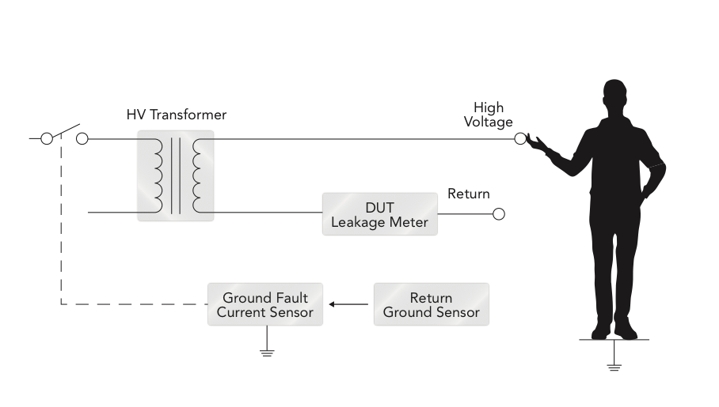
SmartGFI®

Slide 29

Smart GFI Video

Slide 30
Arc Detection
Arcing is a momentary partial discharge due to the intense concentration of a high voltage electric field across a dielectric
In Hipot testing, the dielectric is the insulation of the device under test (DUT)
Arcing produces momentary spikes in the nominal leakage current waveform
Arcing is different from dielectric breakdown
Arc failure does not necessarily mean hipot failure
Arc detection provides useful information about the product’s insulation

Slide 31
Arc Detection

Slide 32
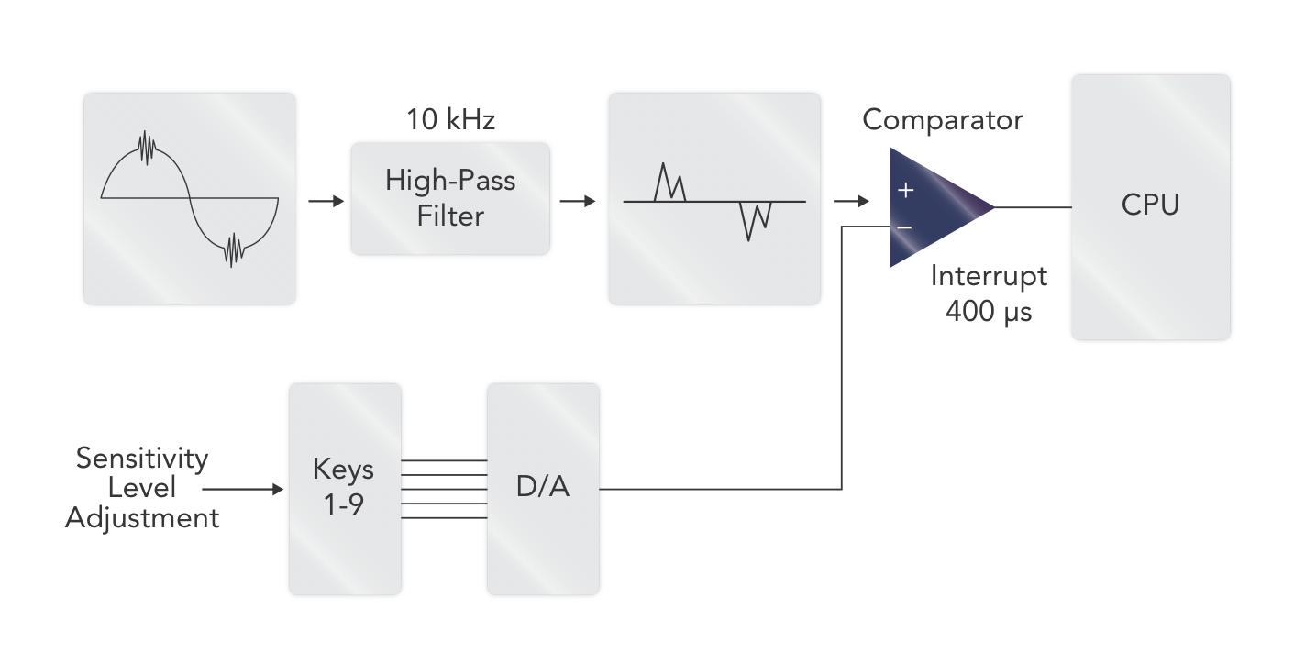
Arc Detection

Slide 33
Arc Detection
Arc Setting | mA Trip Level
1 | 20
2 | 17.75
3 | 15.5
4 | 13.25
5 | 11
6 | 8.75
7 | 6.5
8 | 4.25
9 | 2
It’s important to remember that this method of arc detection is NOT an exact science. There are many variables involved including surface geometry, altitude, atmospheric pressure etc.

Slide 34
Arc Detect Video

Slide 35

Questions?

Slide 36

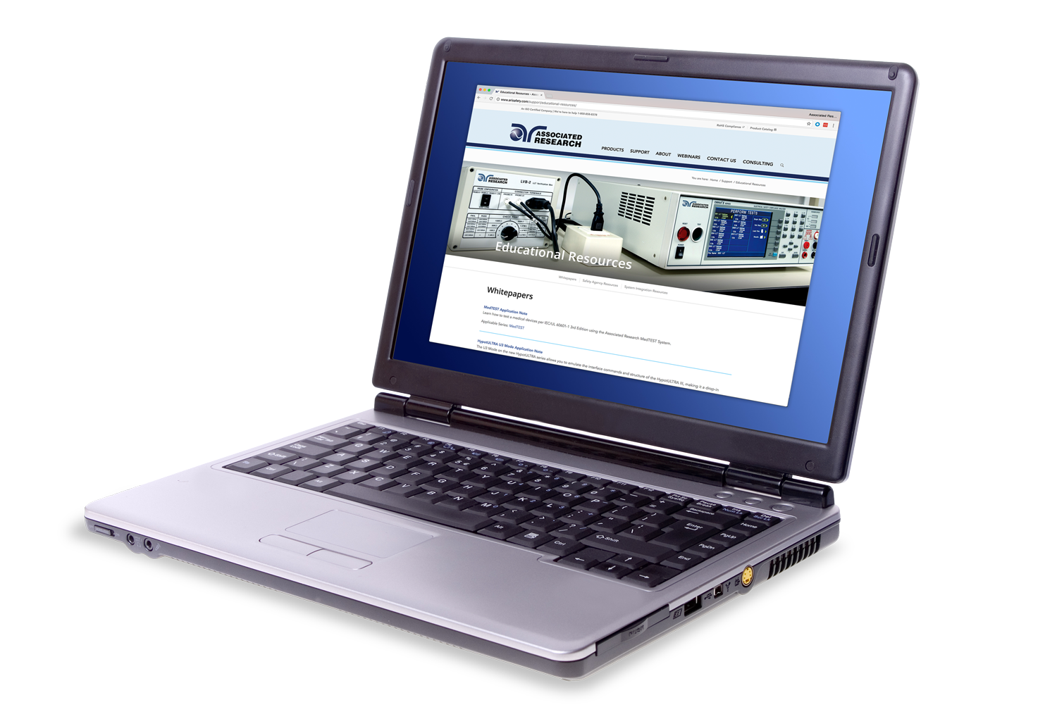
Resources
Visit us online to view all of our Educational Resources:
http://www.arisafety.com/support/educational-resources/

Slide 37
Join us for our Next Webinar
The Hipot Test
Wednesday, May 17 at 10 A.M. CST

Slide 38


Need One-On-One Assistance with your Application?
Nobody understands electrical safety testing better than we do.
Overcome challenges and mitigate risks on the production line and in the laboratory
Safety Standard Analysis
Safe and Effective Test Setups
For more details email applications@arisafety.com or call +1-847-367-4077

Slide 39

Contact Us
If you would like a copy of this presentation please email Brittany Socha at brittany.socha@arisafety.com
Check out our website for more information arisafety.com

